Slide 1
Crop-Aware Panoptic Segmentation
Mehdi Naouar, Ben Bausch, Yannick Vogt

Slide 2
The Most Important Rules
Use only TeXPoint for formulas
Set your Language to English (US)
Spell your slides (press F7)
Videos should be
MP4 with H.264 standard settings or
MS RLE encoding for animations
Use MS Office 2010/2011 and not OpenOffice and friends

Slide 3
Other Important Rules
Set TexPoint resolution to 600 dpi
To include eps images, use the \includegraphics command in TeXPoint
The font is always Verdana
Do not use a line spacing below 1
Do not use page numbers or other footers on slides
Font embedding: Tools-Options-Save- Embed TT fonts->Embed all chars

Slide 4
Colors & Shapes
Blue has a RGB value of: 51, 102, 153
Red has a RGB value: 154, 0, 0
Some good example shapes are

Slide 5
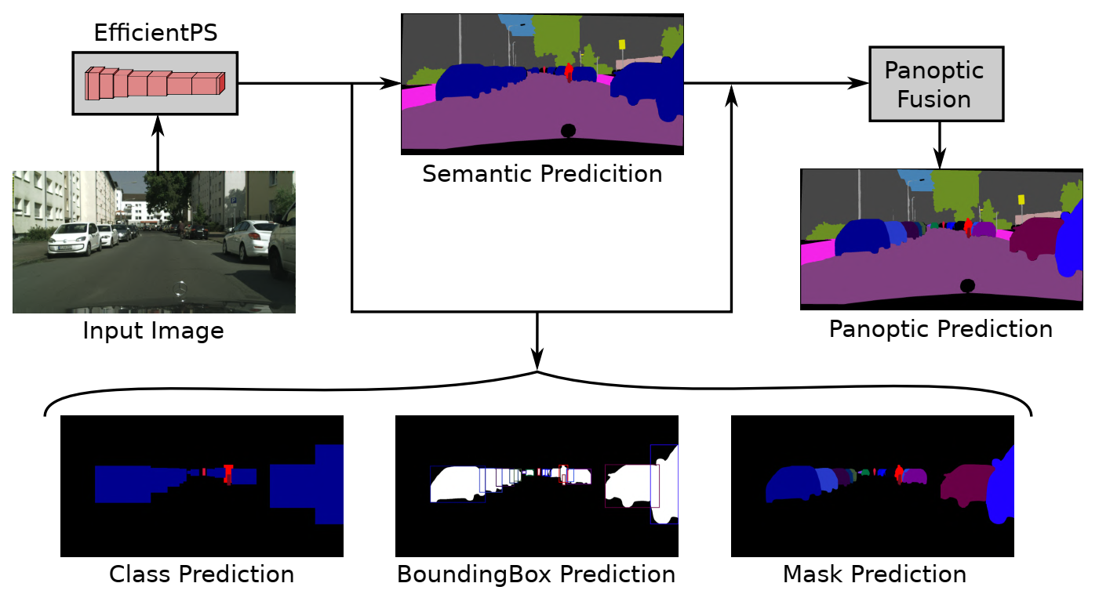
Motivation
Notes:
What is Panoptic Segmentation?
Whats the goal?
Rohits Paper

Slide 6
Bounding Box Parametrization
Delta omega explained?
Why do we even need delta omega?
Shows why its not a trivial solution

Slide 7
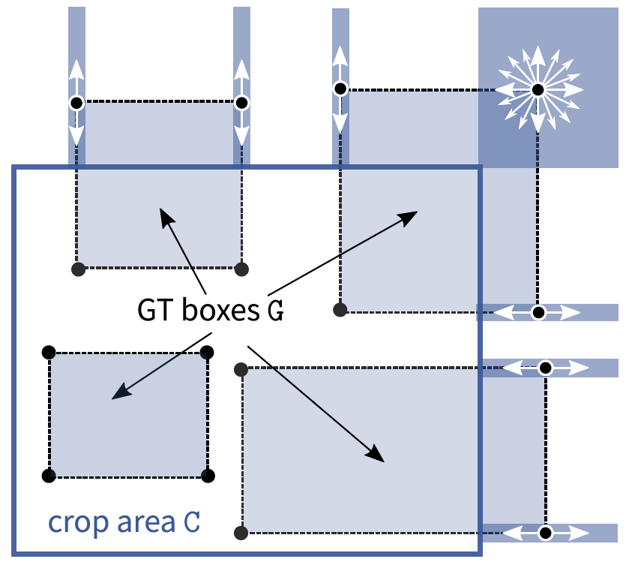
Crop-Aware Bounding Boxes
Network is allowed to hallucinate outside the crop area
Can reduce the bias against big objects which are cut
Training on crops with fine details can increase performance on small/far objects
Notes:
With CABB is an adapted version is a greater equal in SOLVE O1

Slide 8
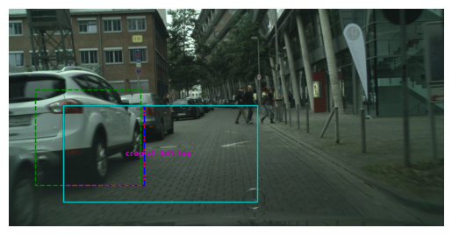
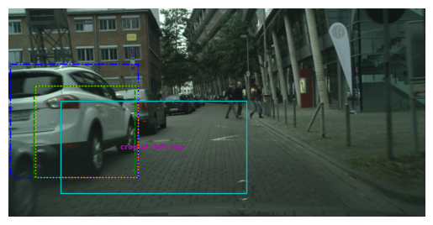
Visualization of Cabb
Without CABB
With CABB
Notes:
TODO add loss values here

Slide 9
Training Setting
Image size, Crop size
Image per GPU

Slide 10
Results/Comparison
Final values
Graph with history?
Training speed difference(look when episode saves were created)!
Difference in final images?

Slide 11
Unaccaunted Case of omega_p = omega_hat??
Would need to first incroduce the algorithms and then show how it can happen

Slide 12
Thank you for your attention!

